Slide 1
Linear Regression and Feature Engineering
Dr. Sourasekhar Banerjee (Ph.D.)

Slide 2
Intended Learning Outcomes
Understand linear regression
Understand gradient descent method
We mostly focus on how to use them in your research and work
Understand feature engineering methods, and their applications

Slide 3
Machine Learning and its types
Machine Learning
Supervised
Unsupervised
Reinforcement
Classification
Regression
Clustering
Decision Making
Logistic Regression
Naive Bayes
KNN
Decision Tree
SVM
Random Forest
Linear Regression
Support Vector Regression
Lasso Regression
Ridge Regression
Partitioning Clustering
Density-based
Hierarchical Clustering
Grid-based Clustering
Model-based
Markov Decision process
Q-Learning
Deep Q-Learning
…
…
…
…

Slide 4


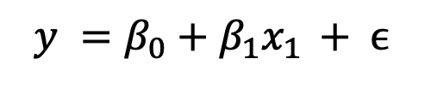
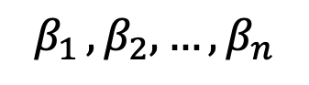
Linear Regression
Simple linear regression.
A statistical method
used to model the relationship between a dependent variable (target) and one or model independent variables (predictors)
fit a linear equation to the observed data.
$$y =β_{0}+β_{1}x_{1 }+ ϵ$$
Multiple-linear regression.
$$y =β_{0}+β_{1}x_{1 }+β_{2}x_{2}+…+β_{n}x_{n}+ ϵ$$
Error
$$x_{1} x_{2}, …, x_{n}$$
Dependable Variable
Bias
Independent Variables
$$β_{1 }, β_{2}, …, β_{n}$$
Coefficients of the independent variables.

Slide 5
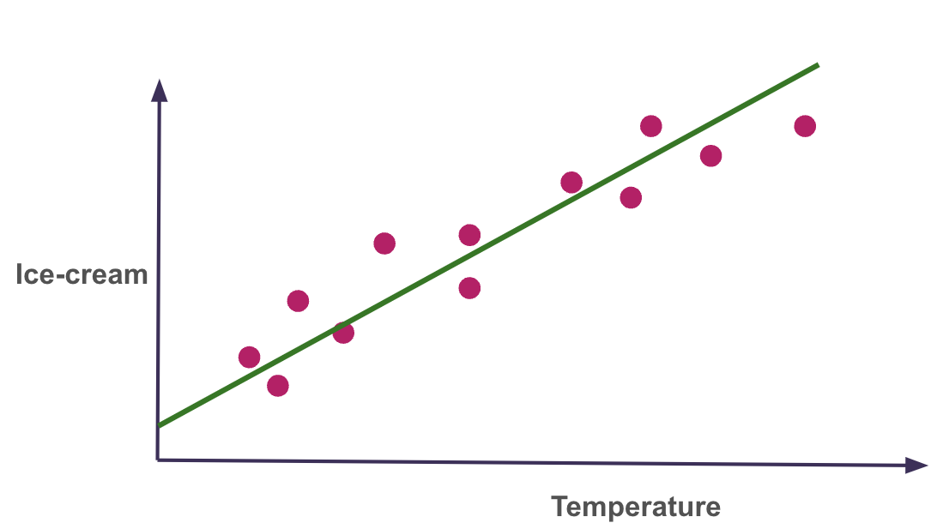
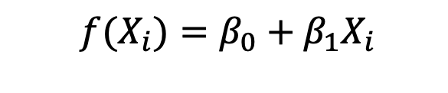
Linear Regression (Example)
Q: given the temperature, what is the predicted number of ice-cream that I will sell?
Assumption: There is a linear relationship between the temperature (independent variable) and sold ice-cream (dependent variable)
Linear model: dependent variable is a weighted sum of the independent variable, plus a bias (intercept)
$$f(X_{i})=β_{0}+β_{1}X_{i}$$

Slide 6
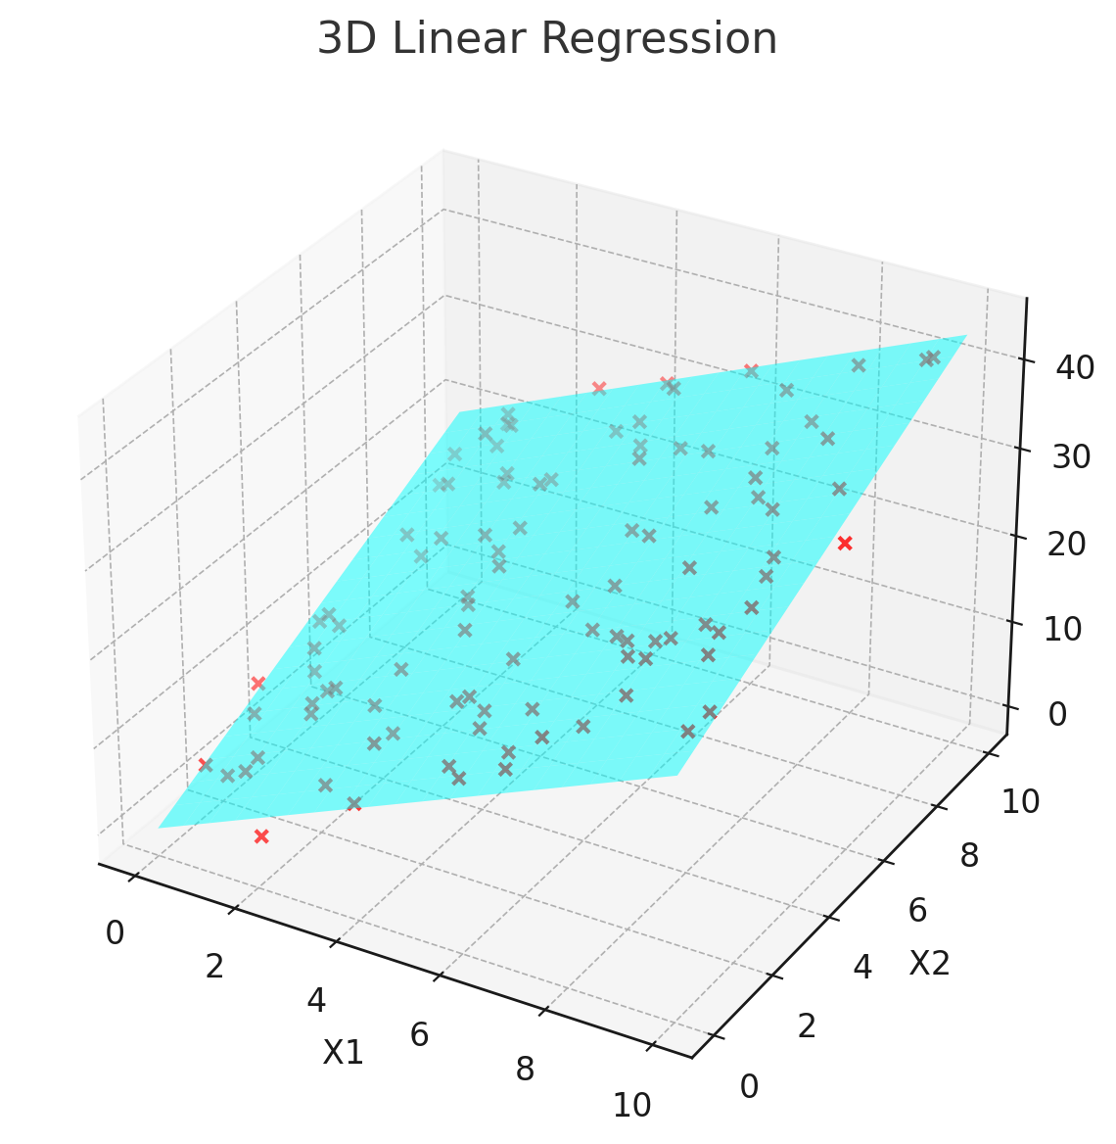
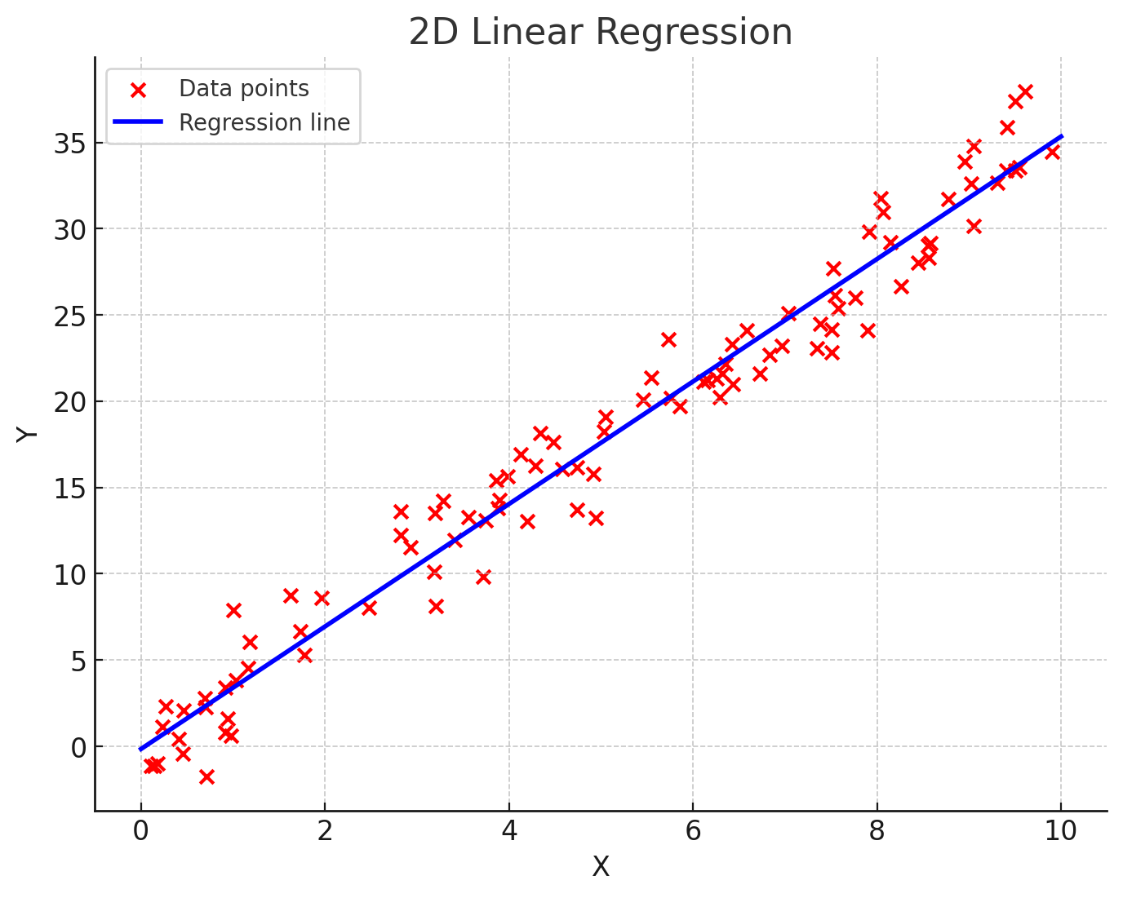
Graphical representation of Linear model
A line in 2-D (one independent variable)
A plane in 3-D (two independent variables)
A hyperplane in d-dimension (d-1 independent variables)

Slide 7
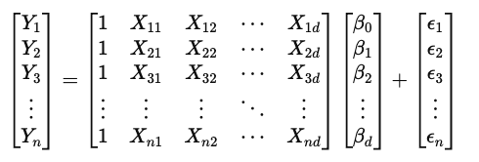
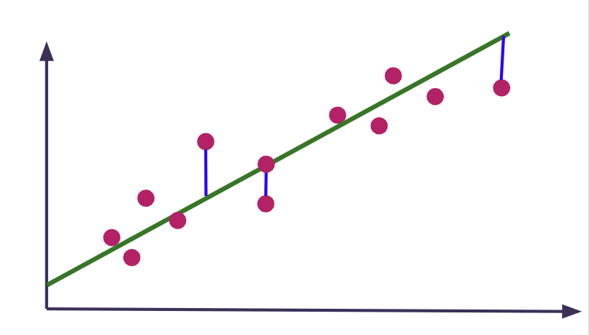
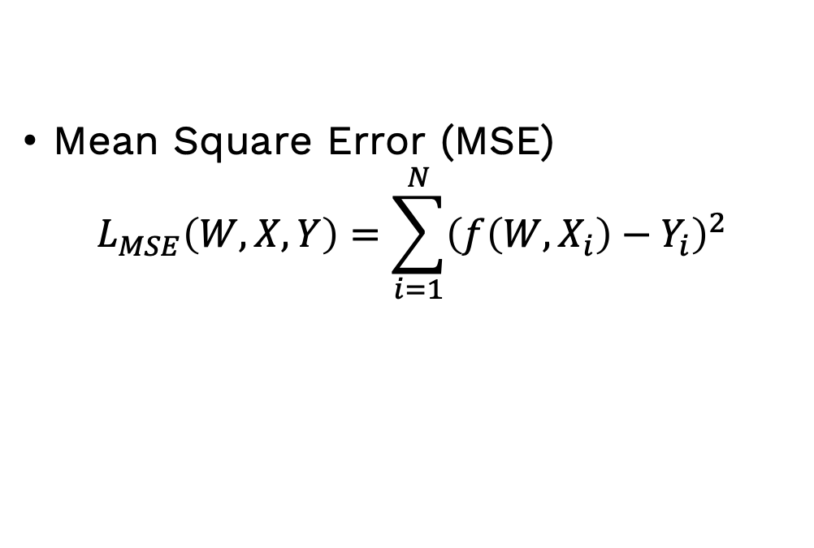

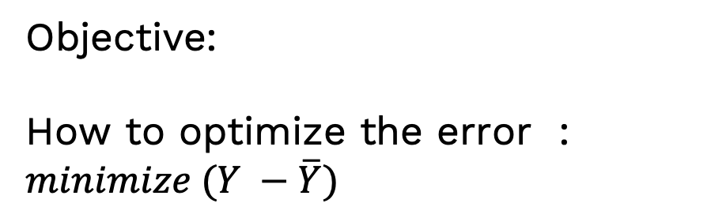
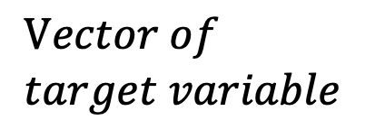

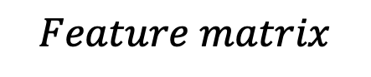
Linear Regression
$$Feature matrix$$
$$Vector of \\ target variable$$
$$Y≈XW$$
$$\overline{Y}=f\left(W,X\right)$$
Weights
Objective:
How to optimize the error : $minimize (Y −\overline{Y})$
Mean Square Error (MSE)
$$L_{MSE}\left(W,X, Y\right)=\sum_{i=1}^{N}{{\left(f\left(W,X_{i}\right)−Y_{i}\right)}^{2}}$$

Slide 8

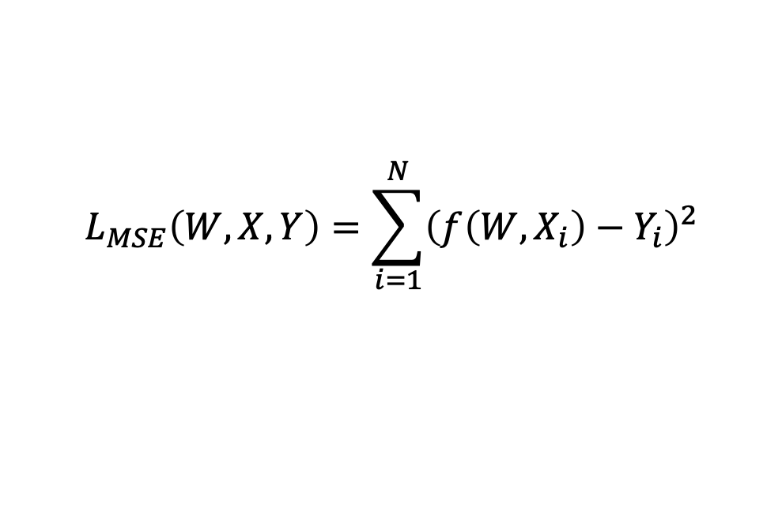

Train a Linear Regression Model
Goal: model the relationship $\overline{Y}=f(W,X)= XW$
Parameter to learn: $W \left(Weights\right) and b \left(bias\right)$
$$L_{MSE}\left(W,X, Y\right)=\sum_{i=1}^{N}{{\left(f\left(W,X_{i}\right)−Y_{i}\right)}^{2}}$$
Optimize Loss function:
Methods
Closed form solution (optimal ): Small dataset
Gradient descent: Useful for Large dataset
$$W^{∗}={\left(X^{T}X\right)}^{−1}X^{T}Y$$

Slide 9
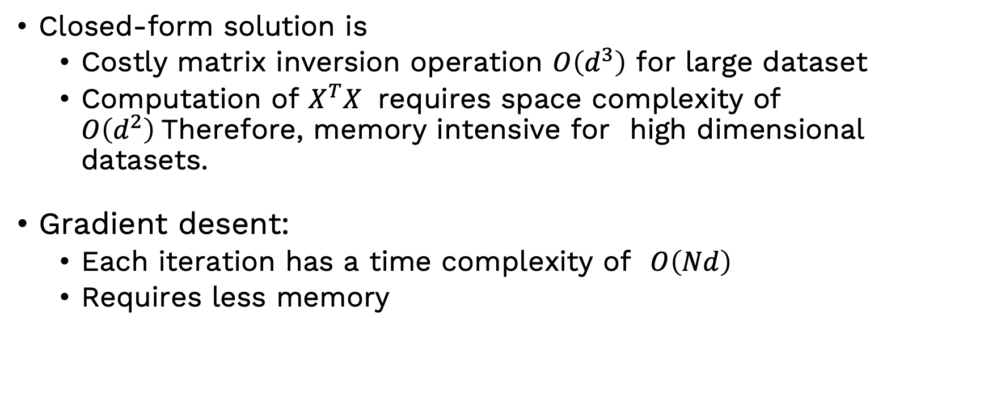
Gradient descent vs closed-form
Closed-form solution is
Costly matrix inversion operation $O\left(d^{3}\right)$ for large dataset
Computation of $X^{T}X$ requires space complexity of $O\left(d^{2}\right)$Therefore, memory intensive for high dimensional datasets.
Gradient desent:
Each iteration has a time complexity of $O\left(Nd\right)$
Requires less memory

Slide 10
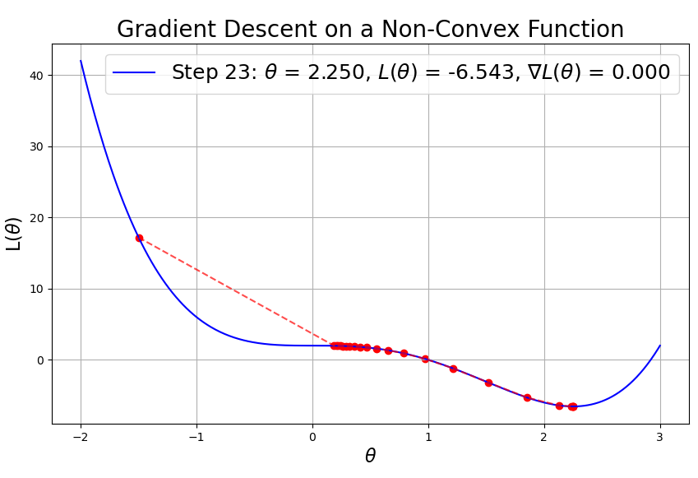
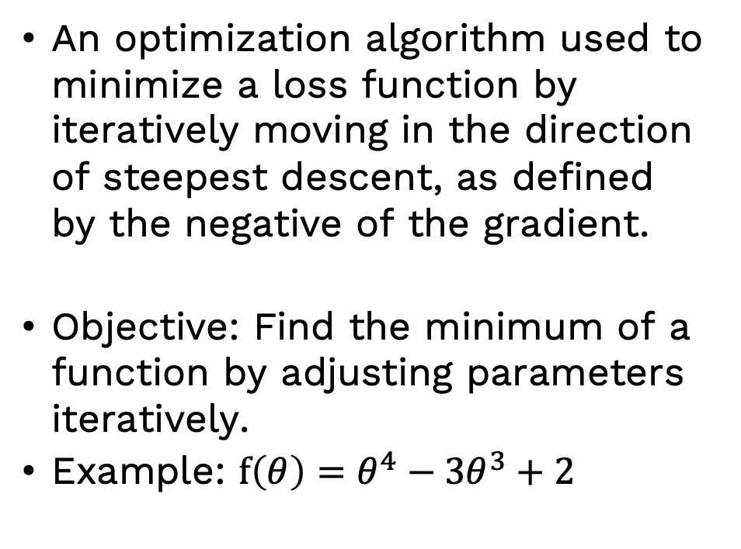
Gradient Descent
An optimization algorithm used to minimize a loss function by iteratively moving in the direction of steepest descent, as defined by the negative of the gradient.
Objective: Find the minimum of a function by adjusting parameters iteratively.
Example: $f\left(θ\right)=θ^{4}−3θ^{3}+2$

Slide 11
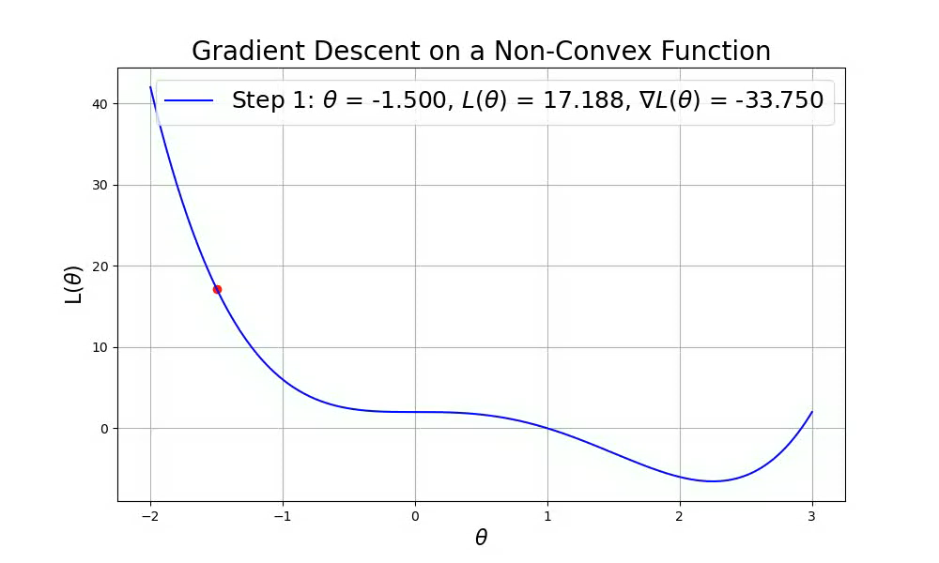
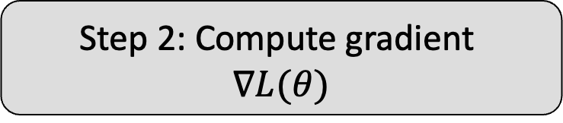
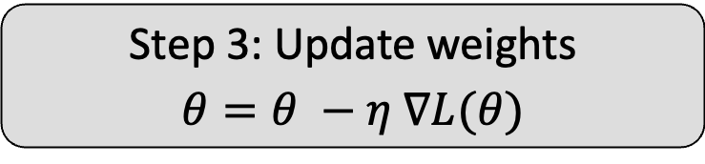
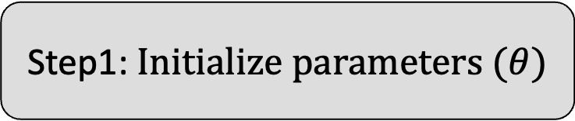
Gradient Descent (Contd.)
Step1: $Initialize parameters (θ)$
Step 2: Compute gradient $$∇L(θ)$$
Repeat until Convergence
Step 3: Update weights $$θ=θ −η ∇L(θ)$$

Slide 12
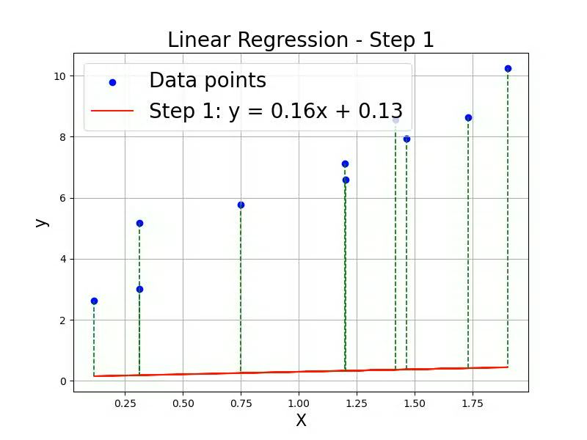
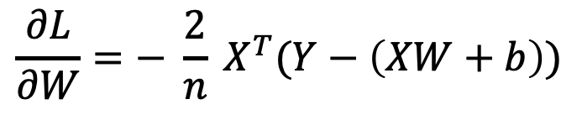
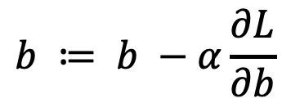
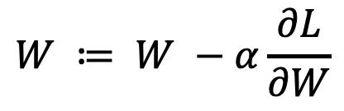
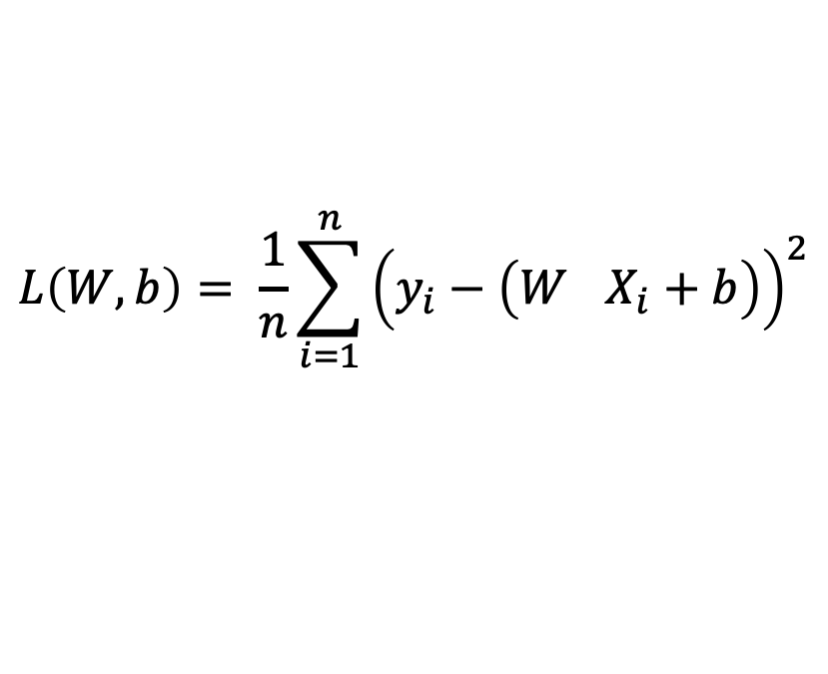
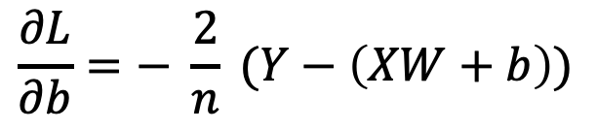
Gradient Descent based Linear Regression
Initialize weights and bias randomly
Define Loss Function (E.g., MSE)
$$L\left(W,b\right)= \frac{1}{n}\sum_{i=1}^{n}{{\left(y_{i}−\left(W^{}X_{i}+b\right)\right)}^{2}}$$
$$W ≔ W −α\frac{∂L}{∂W}$$
Update W and b
$$b ≔ b −α\frac{∂L}{∂b}$$
$$\frac{∂L}{∂W}=− \frac{2}{n} X^{T}(Y−\left(XW+b\right))$$
Gradients
$$\frac{∂L}{∂b}=− \frac{2}{n} (Y−\left(XW+b\right))$$

Slide 13
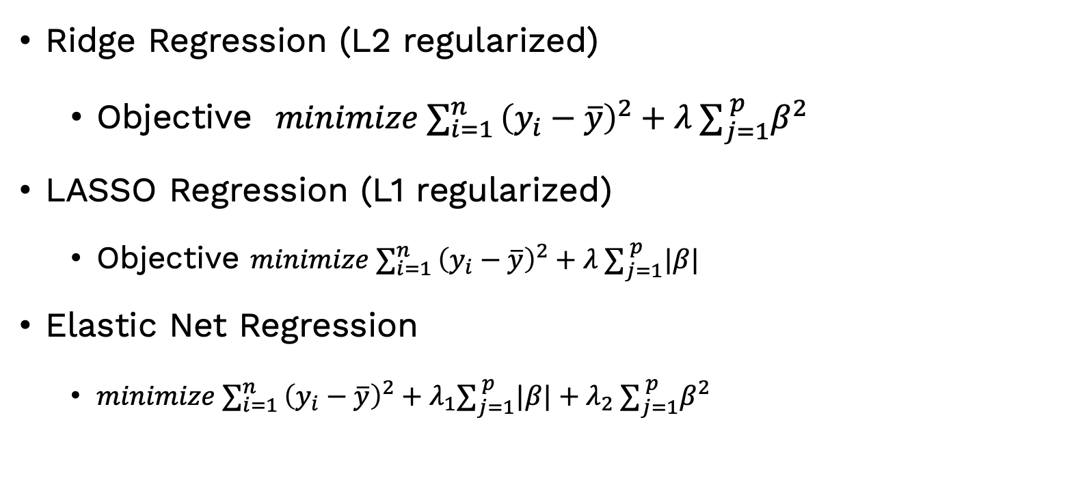
OtherTypes of Linear Regression
Ridge Regression (L2 regularized)
Objective $minimize ∑_{i=1 }^{n}{\left(y_{i}−\overline{y}\right)}^{2}+{λ ∑}_{j=1}^{ p}β^{2}$
LASSO Regression (L1 regularized)
Objective $minimize ∑_{i=1 }^{n}{\left(y_{i}−\overline{y}\right)}^{2}+{λ ∑}_{j=1}^{ p}|β|$
Elastic Net Regression
$minimize ∑_{i=1 }^{n}{\left(y_{i}−\overline{y}\right)}^{2}+{λ_{1}∑}_{j=1}^{ p}|β|+{λ_{2} ∑}_{j=1}^{ p}β^{2}$

Slide 14
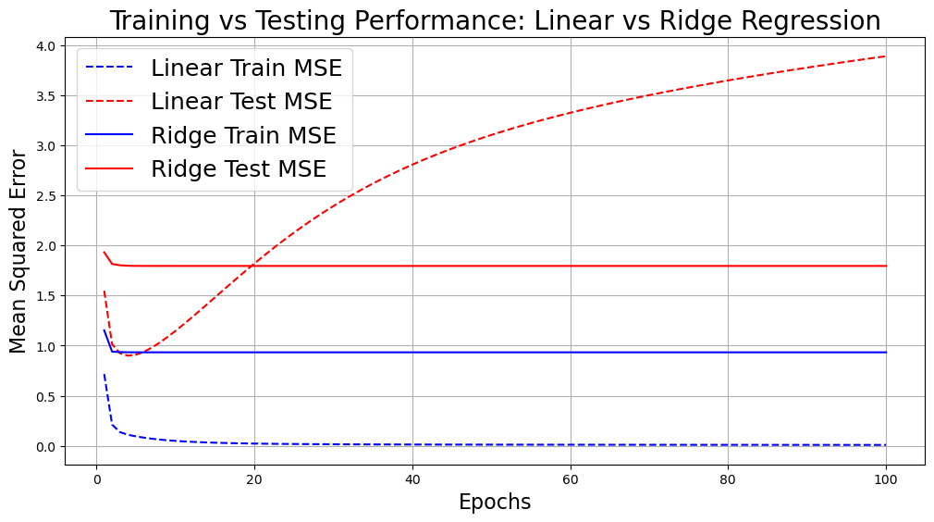
Comparison of Techniques
Techniques | Handles Multicollinearity | Feature Selection | Reduce Overfitting
Simple Regression | No | No | No
Multiple Regression | No | No | No
Ridge Regression | Yes | No | Yes
Lasso Regression | Yes | Yes | Yes
Elastic Net | Yes | Yes | Yes
Overfitting

Slide 15
Hands-on

Slide 16
Feature Engineering
Reduce computational time complexity (and memory usage)
Increase interpretability of data
Increase the performance of the model

Slide 17
Methods
Feature Selection
Feature Extraction
Feature Transformation

Slide 18
Feature Selection
A process of selecting a subset of relevant features for use in model construction.
Goal:
Enhance model performance
reduce dimensionality of data
Decrease Training time
prevent overfitting

Slide 19
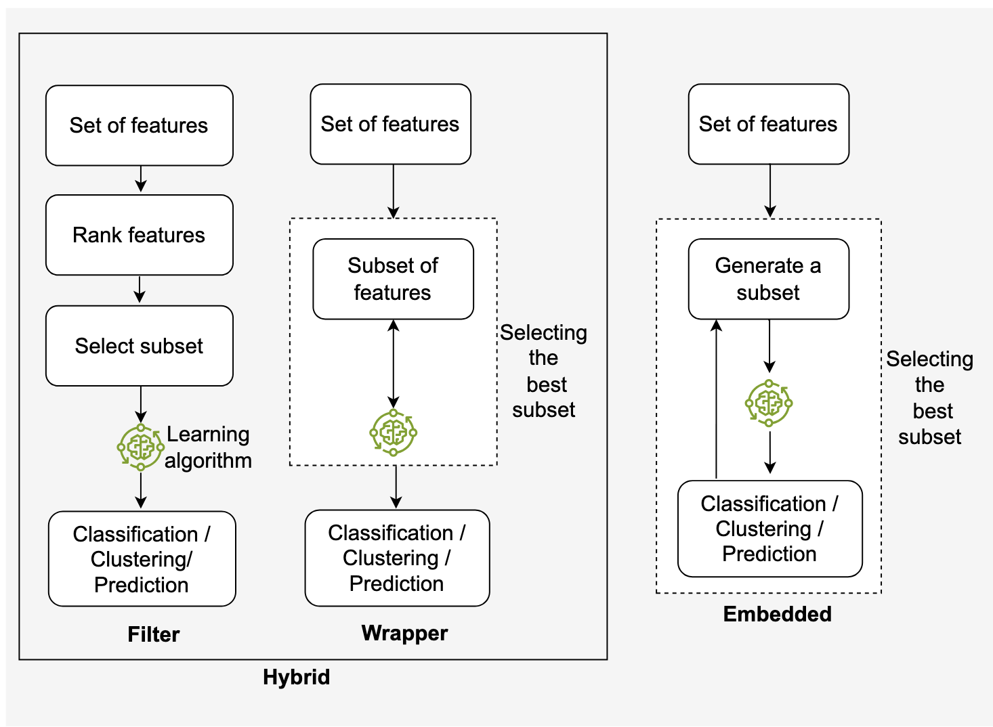
Type of Feature Selection
Filter
Mutual Information
Annova
Wrapper
Forward Selection
Embedded
Ridge/Lasso

Slide 20
Mutual Information
Compute Mutual Information: Calculate the MI between each feature and the target variable
Rank Features: Rank features based on their MI score (higher MI indicates stronger relevance)
Select Top Features: Choose the top k features with the highest MI scores.

Slide 21
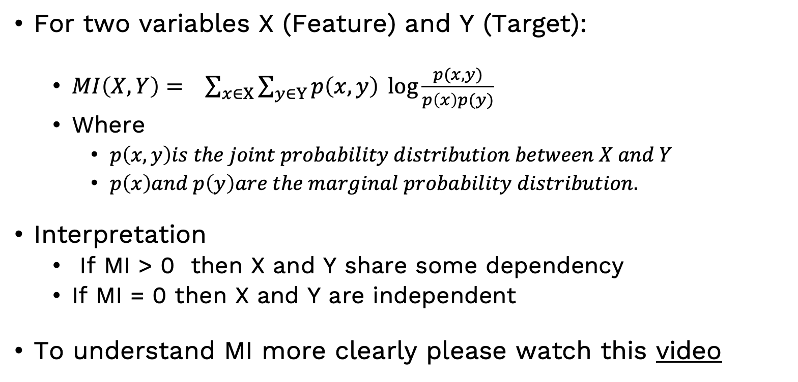
How Mutual Information Works
For two variables X (Feature) and Y (Target):
$MI\left(X,Y\right)= \sum_{x∈X}{\sum_{y∈Y}{p\left(x,y\right)\log{\frac{p(x,y)}{p\left(x\right)p(y)}}}}$
Where
$p\left(x,y\right)is the joint probability distribution between X and Y$
$p\left(x\right)and p\left(y\right)are the marginal probability distribution.$
Interpretation
If MI > 0 then X and Y share some dependency
If MI = 0 then X and Y are independent
To understand MI more clearly please watch this video

Slide 22
Hands-on

Slide 23
Feature Extraction
Aspect | Feature Selection | Feature Extraction
Definition | Selects a subset of the existing features without altering them. | Creates new features by transforming the original data.
Objective | Reduces dimensionality by choosing the most important features. | Captures the most informative aspects of data in a new representation.
Techniques | Filter, wrapper, embedded | PCA, LDA, Autoencoders, …
Nature of features | Works with existing features. | Generates new features that may not directly correspond to original features.
Interpretability | Easy to interpret since it retains original features. | May reduce interpretability as features are transformed or abstract.
When to use | When you want to retain the original features and reduce redundancy. | When transforming data into a lower-dimensional space is needed.

Slide 24
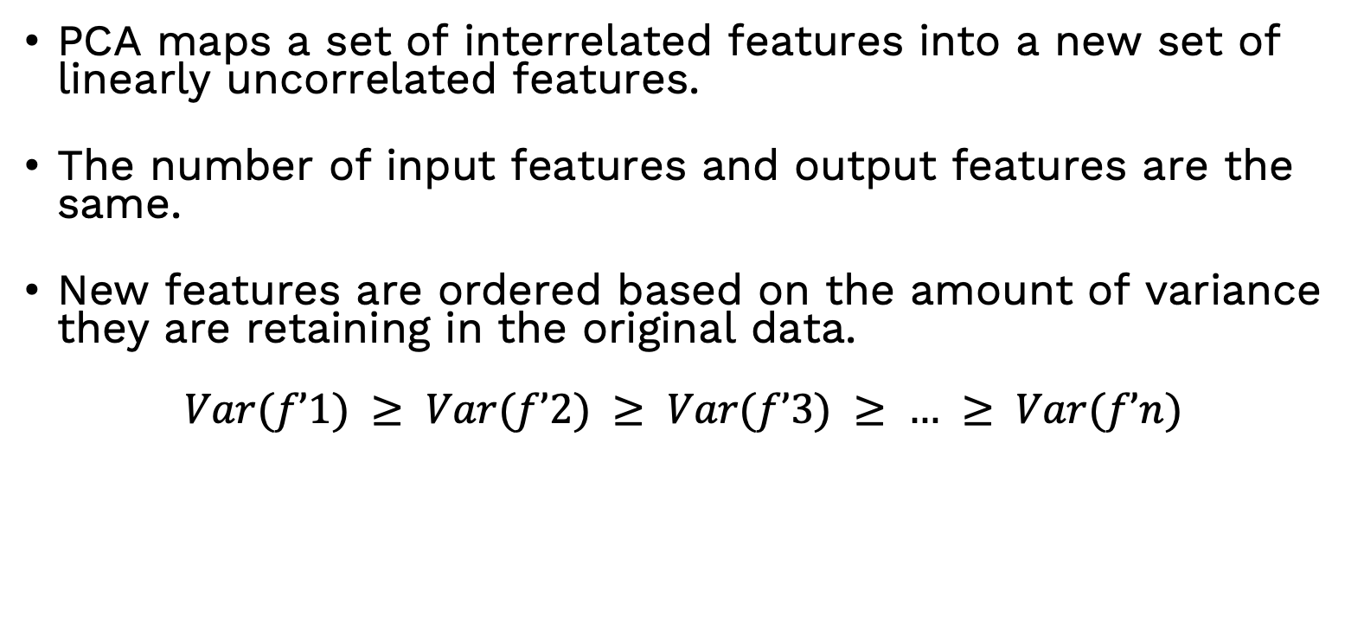
Principal Component Analysis (PCA)
PCA maps a set of interrelated features into a new set of linearly uncorrelated features.
The number of input features and output features are the same.
New features are ordered based on the amount of variance they are retaining in the original data.
$$Var(f’1) ≥ Var(f’2) ≥ Var(f’3) ≥ … ≥ Var(f’n)$$
ID | f1 | f2 | … | fn | Class
1 | 4.3 | 4.9 | … | 4.7 | Healthy
2 | 3.9 | 6.1 | … | 5.5 | Healthy
3 | 2.7 | 4.8 | … | 5 | Healthy
4 | 6.6 | 4.4 | … | 3.9 | Sick
5 | 6.5 | 2.9 | … | 4.6 | Sick
6 | 6.5 | 4.1 | … | 5.5 | Healthy
ID | f’1 | f’2 | … | f’n | Class
1 | 11 | 3 | … | 0.9 | Healthy
2 | 5.4 | 3.5 | … | 1 | Healthy
3 | 1 | 2.7 | … | 0.95 | Healthy
4 | 8 | 2.1 | … | 0.61 | Sick
5 | 7.5 | 2 | … | 0.92 | Sick
6 | 7.5 | 2.5 | … | 1 | Healthy
PCA

Slide 25
PCA
Goals of Principal Component Analysis (PCA)
Dimensionality Reduction: Reduce the number of features while retaining the maximum amount of variance in the data.
Eliminate Redundancy: Combine correlated features into fewer uncorrelated components.
Improve Model Performance: Simplify models by removing irrelevant or less important features.
Visualization: Help visualize high-dimensional data in 2D or 3D space.
Preprocessing: Act as a preprocessing step for other machine learning algorithms.

Slide 26
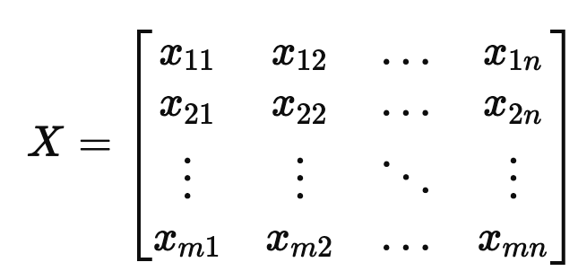
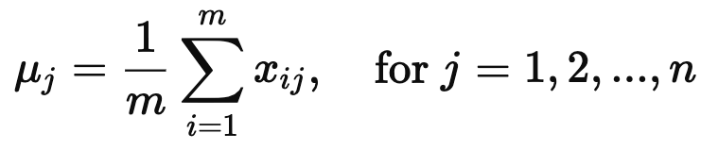
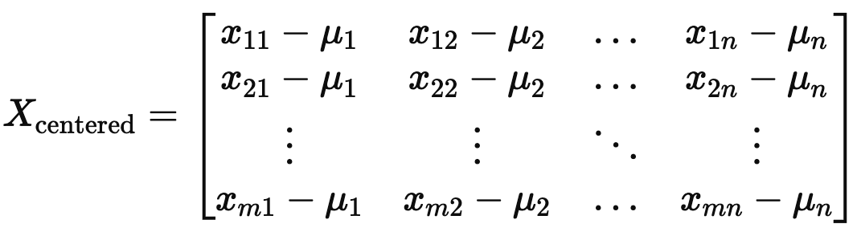
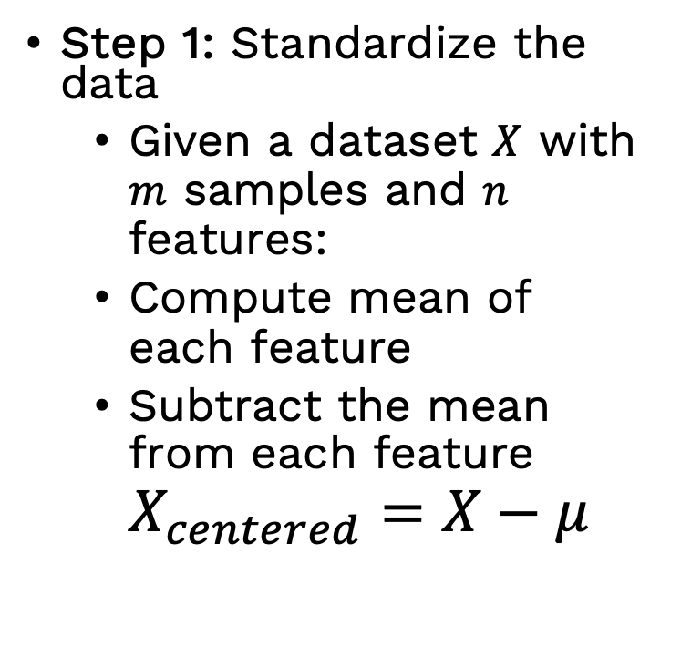
How PCA works ?
Step 1: Standardize the data
Given a dataset $X$ with $m$ samples and $n$ features:
Compute mean of each feature
Subtract the mean from each feature $X_{centered}​=X−μ$

Slide 27
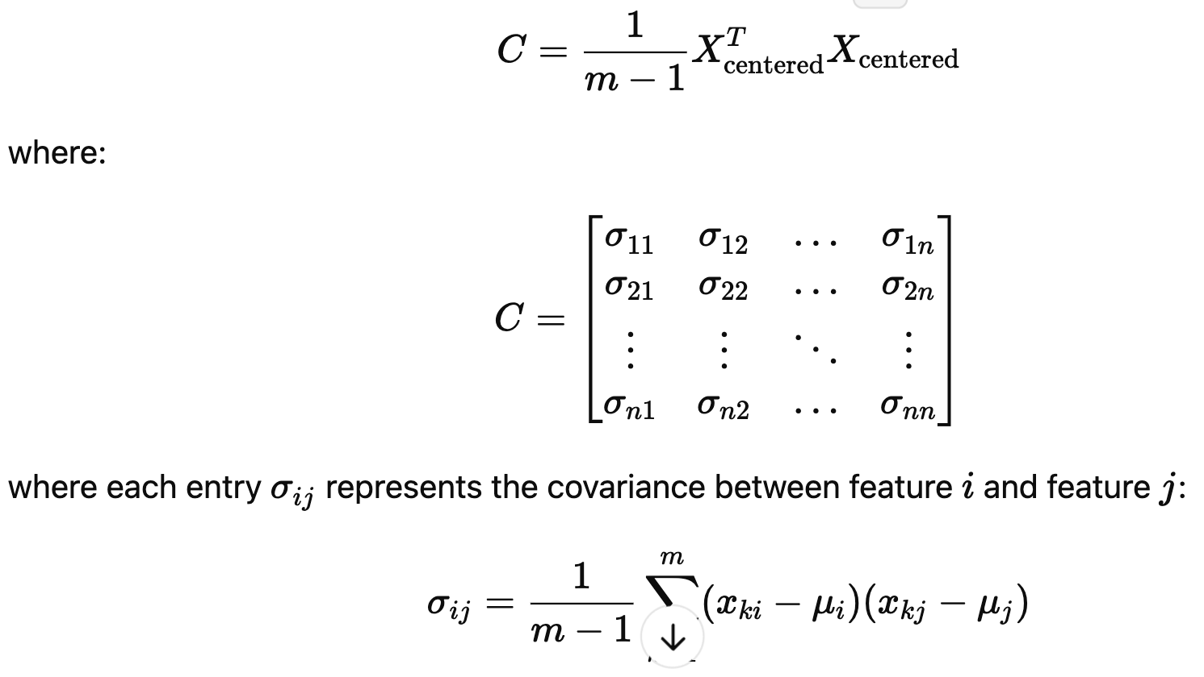
PCA
Step 2: Compute the Covariance Matrix
The Covariance Matrix describes how different features vary together

Slide 28
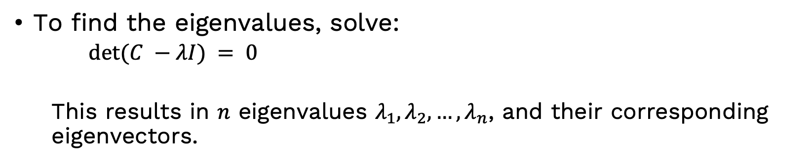
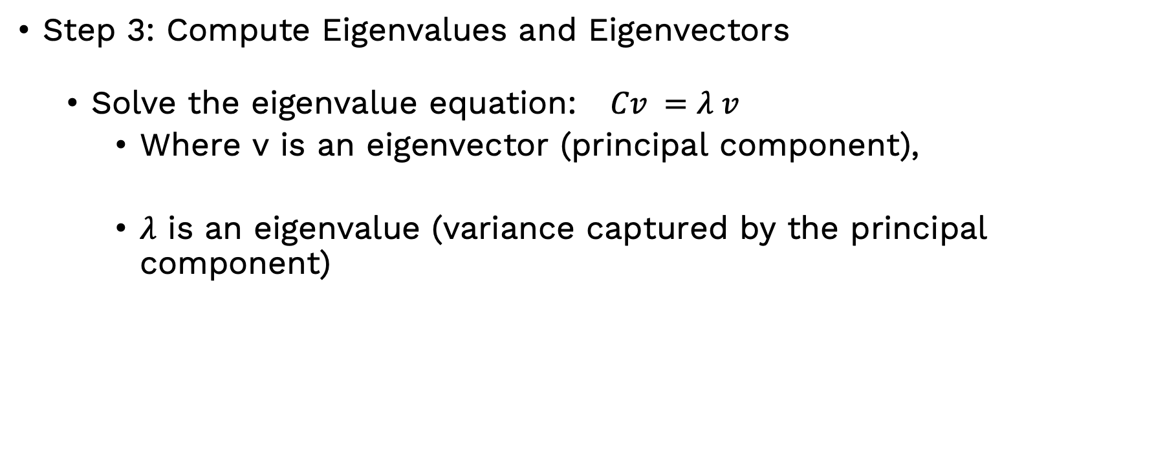
PCA
Step 3: Compute Eigenvalues and Eigenvectors
Solve the eigenvalue equation: $Cv =λ v$
Where v is an eigenvector (principal component),
$λ$ is an eigenvalue (variance captured by the principal component)
To find the eigenvalues, solve:
$det⁡(C −λI) = 0$
This results in $n$ eigenvalues $λ_{1}, λ_{2}, …, λ_{n}$, and their corresponding eigenvectors.

Slide 29
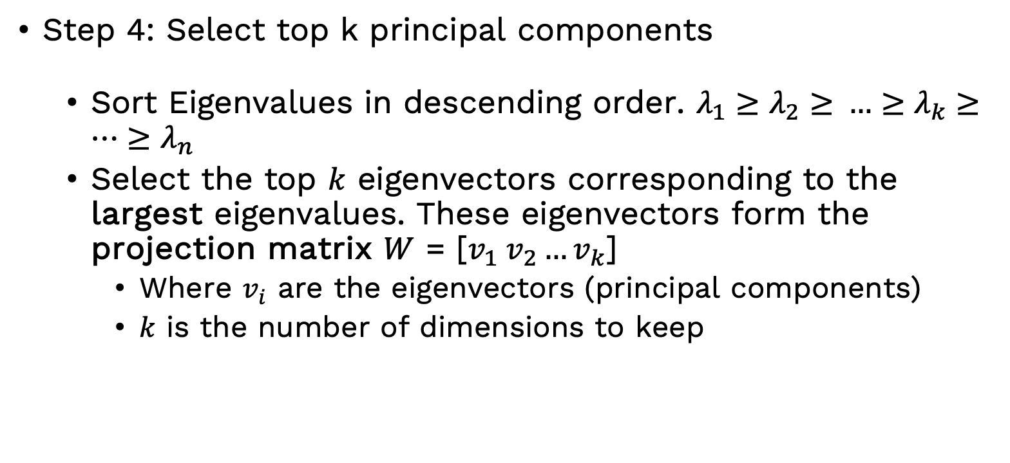
PCA
Step 4: Select top k principal components
Sort Eigenvalues in descending order. $λ_{1}​≥λ_{2}≥​…≥λ_{k}≥…{≥λ}_{n}$
Select the top $k$ eigenvectors corresponding to the largest eigenvalues. These eigenvectors form the projection matrix $W$ = [$v_{1} v_{2}…v_{k}$]
Where $v_{i}$ are the eigenvectors (principal components)
$k$ is the number of dimensions to keep

Slide 30
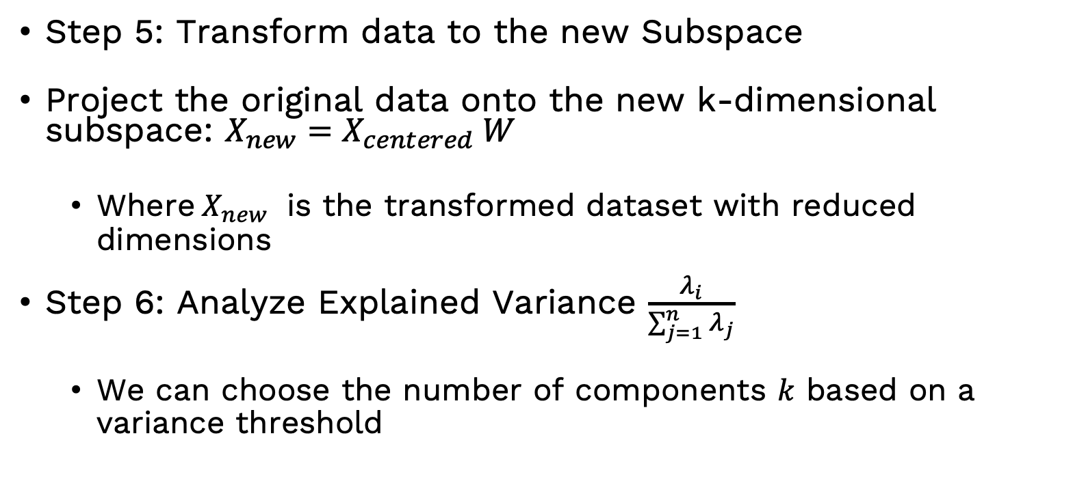
PCA
Step 5: Transform data to the new Subspace
Project the original data onto the new k-dimensional subspace: $X_{new}=X_{centered} W$
Where$X_{new}$ is the transformed dataset with reduced dimensions
Step 6: Analyze Explained Variance $\frac{λ_{i}}{\sum_{j=1}^{n}{λ_{j}}}$
We can choose the number of components $k$ based on a variance threshold

Slide 31
Hands-on

Slide 32
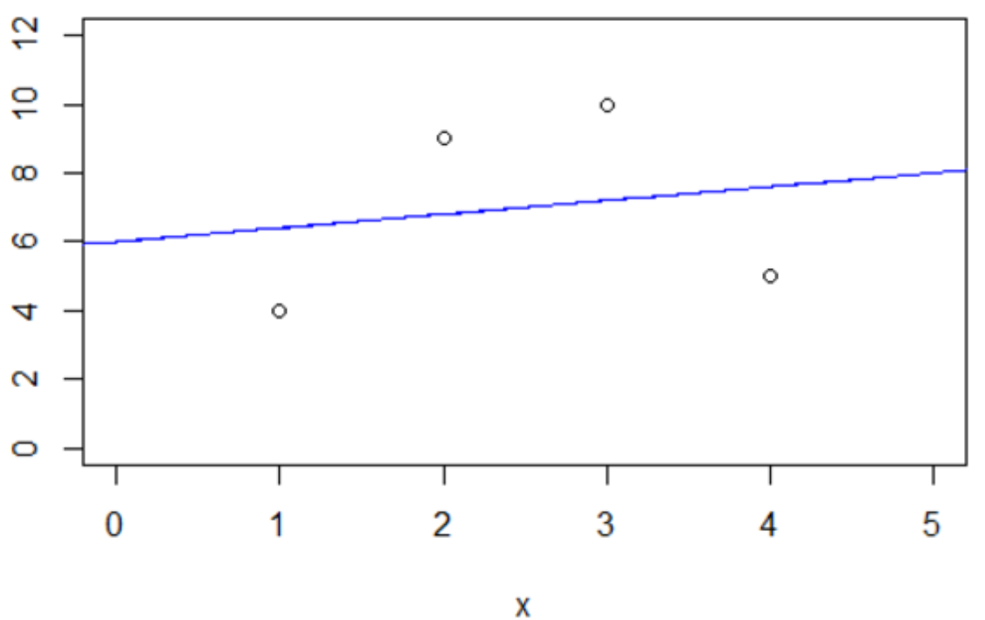
Feature Transformations and Non-linear Features
Feature transformation: converts raw data features into a different scale
Objective is to enhance the learning process.
Methods: normalization, standardization, encoding, and mathematical transformations.
Why Use Non-Linear Features?
Linear models assume a linear relationship between input features and output.
Real-world data exhibits non-linearity.
Transforming features helps the model learn better decision boundaries.
Consider the ordinary least square (OLS) linear regression model (right) generated from the following dataset
X | Y
1 | 4
2 | 9
3 | 10
4 | 5

Slide 33
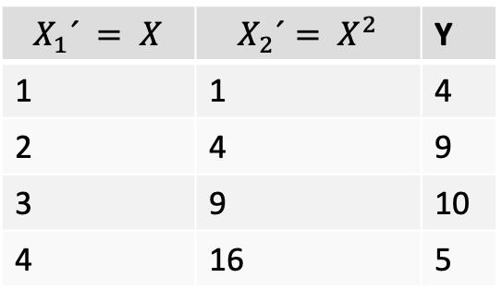
Feature Transformations (Contd.)
X | Y
1 | 4
2 | 9
3 | 10
4 | 5
Feature Transformation
$$X_{1}´ = X$$ | $$X_{2}´= X^{2}$$ | Y
1 | 1 | 4
2 | 4 | 9
3 | 9 | 10
4 | 16 | 5
We take a non-linear transformation of our features to generate a new, transformed data set

Slide 34
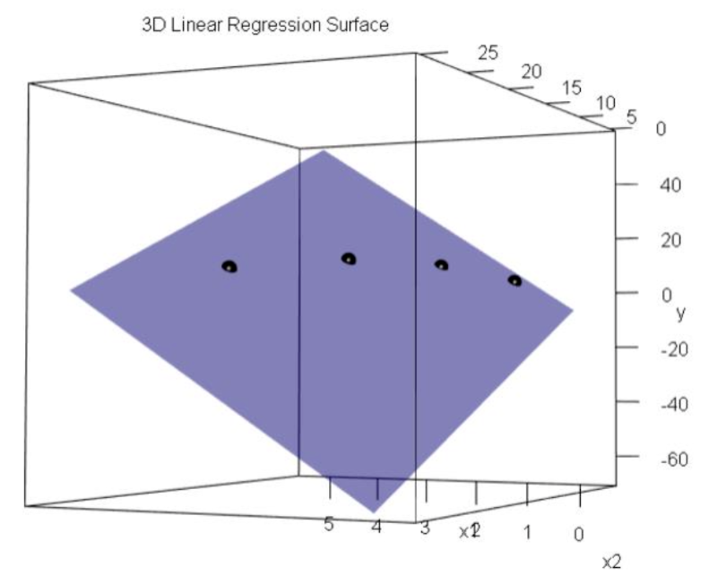
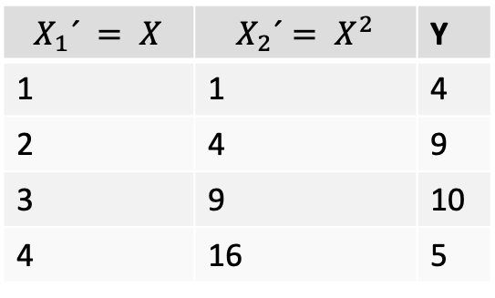
Feature Transformations (Contd.)
Now we make an OLS linear regression model from the new transformed data. The model is, of course, still linear (X' ∈ R2 )
$$X_{1}´ = X$$ | $$X_{2}´= X^{2}$$ | Y
1 | 1 | 4
2 | 4 | 9
3 | 9 | 10
4 | 16 | 5

Slide 35
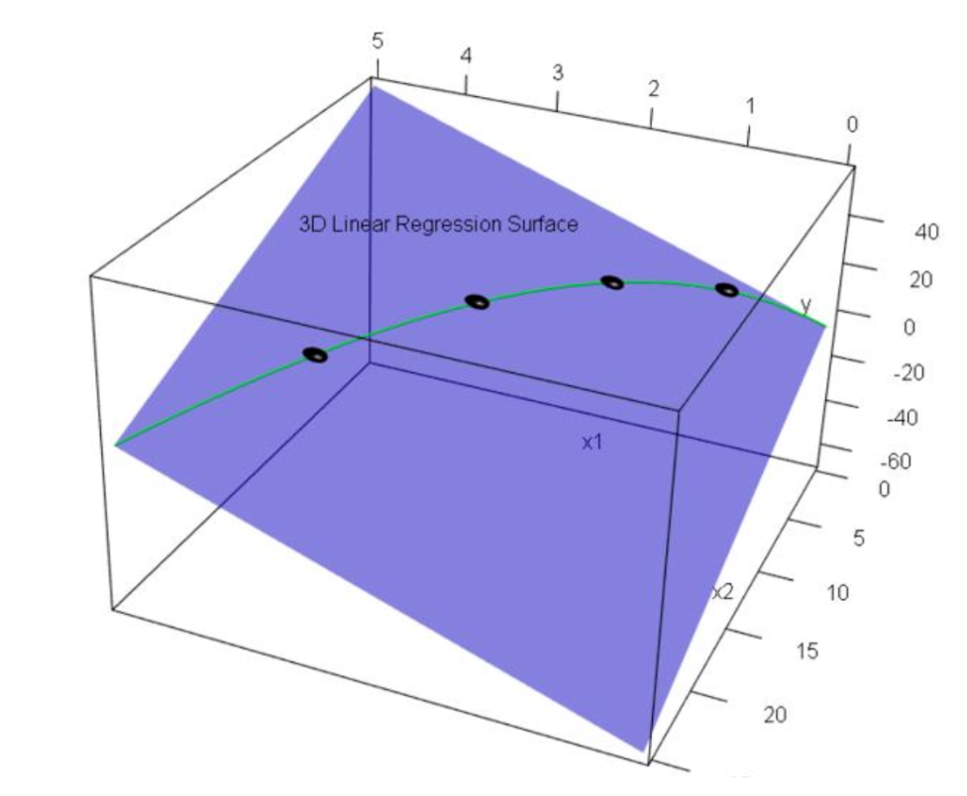
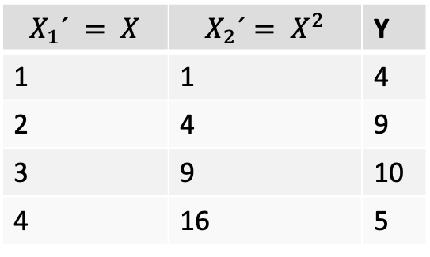
Feature Transformations (Contd.)
Most of the plane represent impossible points.
Only one curve (where X² = X₂') represent possible points.
$$X_{1}´ = X$$ | $$X_{2}´= X^{2}$$ | Y
1 | 1 | 4
2 | 4 | 9
3 | 9 | 10
4 | 16 | 5

Slide 36
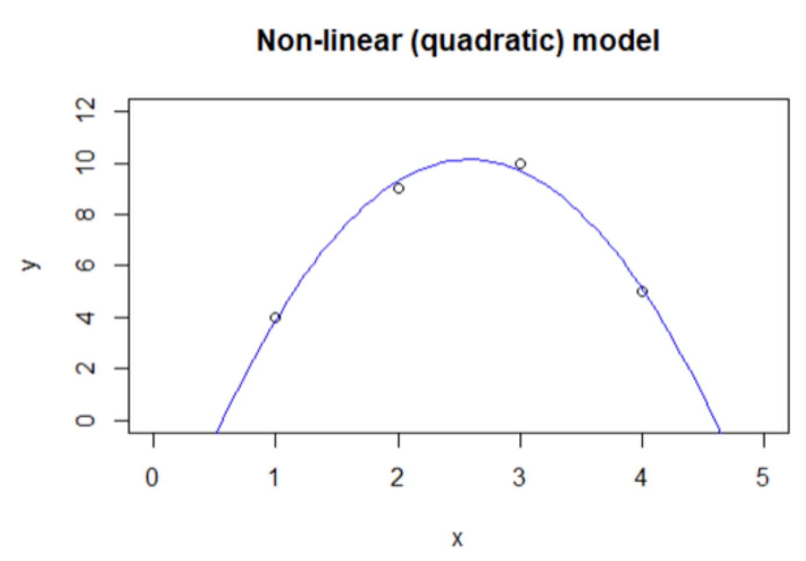
Feature Transformations (Contd.)
We can take that curve and plot the X₁' = X vs. Y values into our original two-dimensional space. And we have a non-linear model
X | Y
1 | 4
2 | 9
3 | 10
4 | 5

Slide 37
Categorical Variable Encoding
What is Categorical Encoding?
Machine learning models work with numerical data
Categorical data must be converted into numerical form
Different encoding techniques are used to represent categorical variables
Types of categorical variables:
Nominal: No order (e.g., Color, Gender)
Ordinal: Has order (e.g., Low, Medium, High)

Slide 38
Categorical Variable Encoding
Label Encoding: Converts each category to a unique integer.
Example: {'Red': 2, 'Blue': 0, 'Green': 1}
One-Hot Encoding:Converts categorical variables into binary columns.
Each category becomes a separate column with values 0 or 1.
Fuel consumption | Brand
2.4 | Volvo
3.7 | Toyota
3 | Honda
2.1 | Volvo
Fuel consumption | Volvo | Toyota | Honda
2.4 | 1 | 0 | 0
3.7 | 0 | 1 | 0
3 | 0 | 0 | 1
2.1 | 1 | 0 | 0
Ordinal Encoding (Custom Order): Assigns custom-defined ordinal values to categories.
Example: {'Blue': 0, 'Green': 1, 'Red': 2}
Target Encoding (Mean Encoding): Replaces a category with the mean of the target variable.

Slide 39
Comparison
Encoding Type | Suitable for | Pros | Cons
Label Encoding | Small categories | Simple | Introduces order
One-Hot Encoding | Nominal variables | No order | High dimensionality
Ordinal Encoding | Ordered categories | Keeps order | Not for nominal
Target Encoding | Large categories | Captures target info | Can cause leakage

Slide 40
Hands-on

